Slide 1
PREDICTION OF CEREBRAL STROKE USING SUPERVISED MACHINE LEARNING
Abdul Rahman M S
B.TECH – INFORMATION TECHNOLOGY

Slide 2
OBJECTIVE
To detect the Cereberal stroke using ADA boost,KNN, Bagging classifier and Decision tree algorithms with higher efficiency and accuracy.
The goal is to develop a novel decision-making tool for predicting strokes.
MOTIVATION
To implement ADA boost,KNN, Bagging classifier and Decision tree algorithm, the system can assist in early stroke detection, predict patient outcomes, and provide personalized treatment recommendations.
SCOPE
The scope of this project is to investigate Brain stroke prediction classification technique using machine learning technique. To identify the Brain stroke, occur or Not.

Slide 3
LITERATURE SURVEY
Year | Author | Description | Challenges
2023 | KRISHNA MRIDHA , SANDESH GHIMIRE , ANMOL ARAN , MD. MEZBAHUDDIN AND M. F. MRIDHA | The research proposes the Stroke prediction algorithms are being developed to enable early intervention and improve stroke care and treatment . | Higher accuracy attained with the rate of higher data leakages.This leads to false prediction
2023 | Deepali Deshpande, Shravani Bahirat, Vaisnavi Dalvi, Sakshi Darawade, Shravani Jagtap, and Sakshi Shakhawar. | The research aims to develop a machine learning model that can predict the likelihood of brain stroke based on various parameters such as gender, age, disease, smoking status, Cystatin-c, MMP10, and Tau. The model utilizes different ML algorithms, including Logistic Regression, KNN, Decision Tree, Random Forest, and SVM, to control and predict stroke risk. | Limited dataset and potential biases in accuracy and generalizability of the ML model.
2023 | Hong-Yu Zhou, Chi-Ken Lu, Chaoqi Chen, Sibei Yang, Yizhou Yu | The framework proposed in the paper is a unified self-supervised learning (SSL) approach for medical image analysis. | The framework aims to address the locality problem in comparative self-supervised learning (SSL) by incorporating pixel restoration, which is vital in medical image analysis .

Slide 4
LITERATURE SURVEY
Year | Author | Description | Challenges
2022 | Valeria Mariano, Jorge A. Tobon Vasquez, Mario R. Casu, Francesca Vipiana | The paper proposes a method to create large datasets for machine learning algorithms used in brain stroke classification via microwave imaging systems. | The distorted Born approximation assumes limited variation between the scenario under test and the background, which may not hold true in all cases.
2023 | M Kishore Babu, Sk Reshma, V Reddy, U Jayanth, and Sk Naheda | The research utilizes a substantial number of hospital entries to build models and predict stroke disorders. | The accuracy and performance of the machine learning models used for stroke detection need to be evaluated and improved .
2023 | Tarun Jain, Priyesh Tiwari | The paper proposes prediction of brain stroke using machine learning algorithms. | Overfitting or underfitting of the models can be a challenge, as it may lead to inaccurate predictions or poor generalization to new data

Slide 5
INTRODUCTION
The domain revolves around medical diagnostics, specifically the prediction of Cerebral Stroke.
Leveraging Supervised machine learning technique such as ADA boost,KNN, Bagging classifier and Decision tree algorithm, we aim to develop proactive intervention strategies tailored to individual risk profiles, potentially improving patient outcomes through timely treatment.

Slide 6
EXISTING SYSTEM
The dataset used for stroke prediction is highly skewed, with a majority of instances indicating the absence of a stroke. This can affect the accuracy and other metrics of the machine learning models .
Accuracy & performance was low.
Higher accuracy attained with high amount of data leakeage.

Slide 7
PROPOSED SOLUTION
The proposed system for cerebral stroke classification using supervised learning approach aims to enhance the accuracy and efficiency of stroke diagnosis through advanced machine learning techniques.
This comprehensive approach allows the model to learn patterns and relationships within the data, enabling it to accurately predict cerebral stroke , based on clinical indicators, and other relevant parameters.
The implementation of this system has the potential to significantly improve the speed and precision of stroke diagnosis, leading to better patient outcomes and more efficient allocation of healthcare resources.

Slide 8
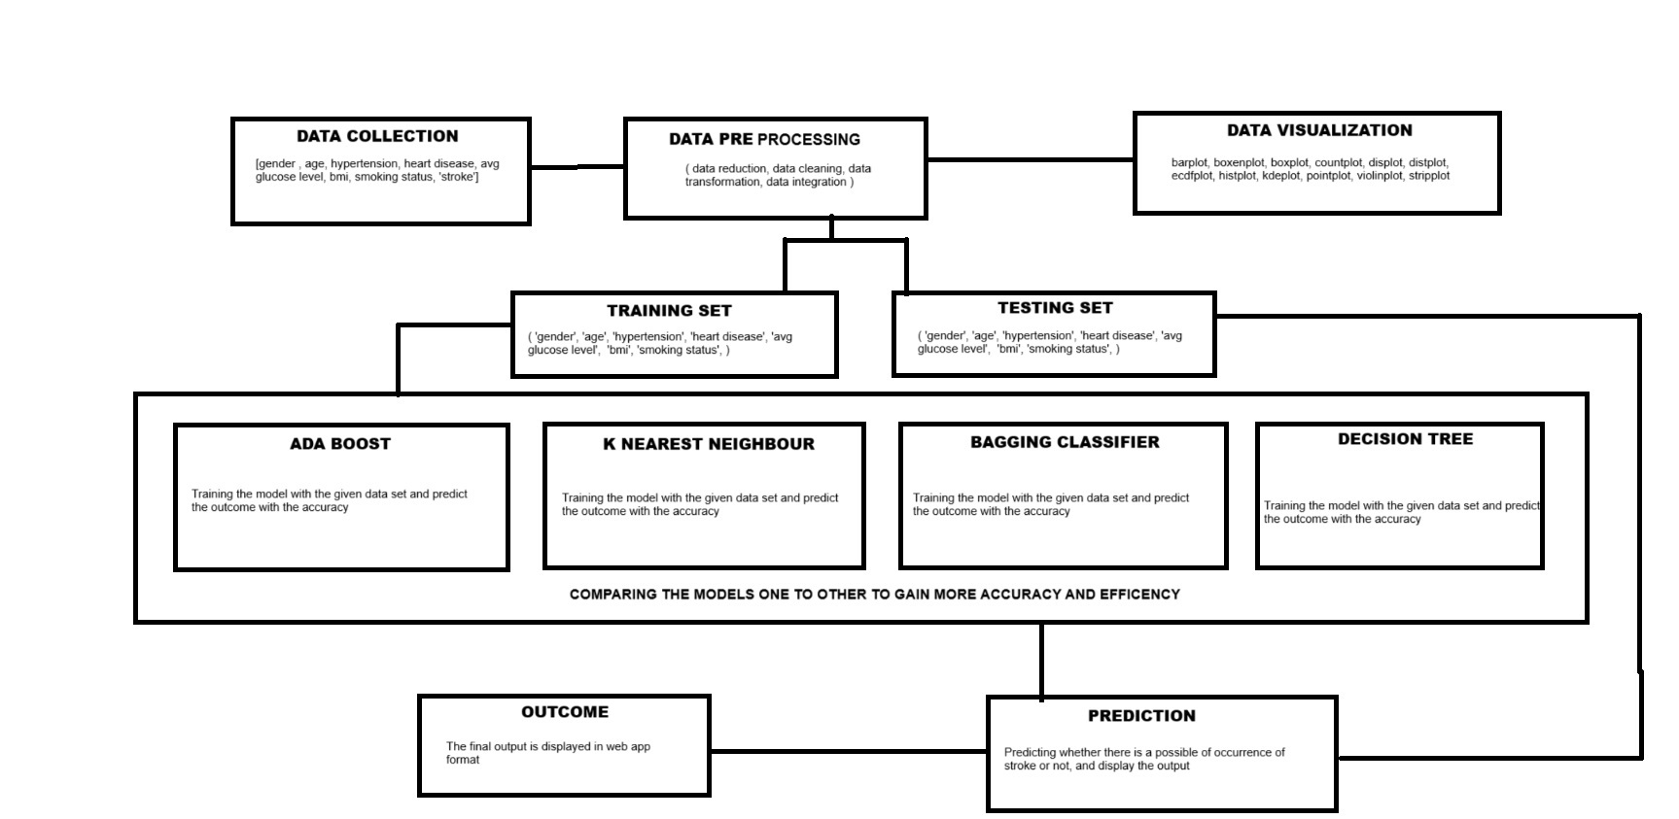
SYSTEM ARCHITECTURE

Slide 9
MODULES
Data Collection
Data Pre-processing
Data Analysis of Visualization
Adaboost
Bagging Classifier
K-Nearest Neighbour
Decision Tree

Slide 10
MODULE IMPLEMENTED
Data Collection
Data is collected from kaggle website
This data acts as input for predicting the cerebral stroke using supervised machine learning approaches.
Data Pre-processing
The missing value, duplicate value and description of data type whether it is float variable or integer from the data set are processed.
NULL values are identified and processed for better outcome.

Slide 11
Data visualization
MODULE IMPLEMENTED
Data sets are visualized using plots,histogram,etc..,
Data sets are expressed and demonstrate key relationships in plots and charts that are more understandable
Adaboost
It operates iteratively, identifying misclassified data points and adjusting their weights to minimize the training error.
It is implemented by combining several weak learners into a single strong learner. The weak learners take into account a single input feature and draw out a single split decision tree called the decision stump. Each observation is weighted equally while drawing out the first decision stump.
We achieved an accuracy rate of 77%

Slide 12
Bagging Classifier
Bagging is a type of ensemble learning in which multiple base models are trained independently and in parallel on different subsets of the training data.
Each subset is generated using bootstrap sampling, in which data points are picked at random with replacement.
In the case of the bagging classifier, the final prediction is made by aggregating the predictions of the all-base model using majority voting.
K-Nearest Neighbour
The K-NN algorithm works by finding the K nearest neighbors to a given data point based on a distance metric, such as Euclidean distance.
The class or value of the data point is then determined by the majority vote or average of the K neighbors. This approach allows the algorithm to adapt to different patterns and make predictions based on the local structure of the data.

Slide 13
Decision Tree
the Decision Tree algorithm selects the best attribute to split the data based on a metric such as entropy or Gini impurity, which measures the level of impurity or randomness in the subsets.
The goal is to find the attribute that maximizes the information gain or the reduction in impurity after the split.

Slide 14
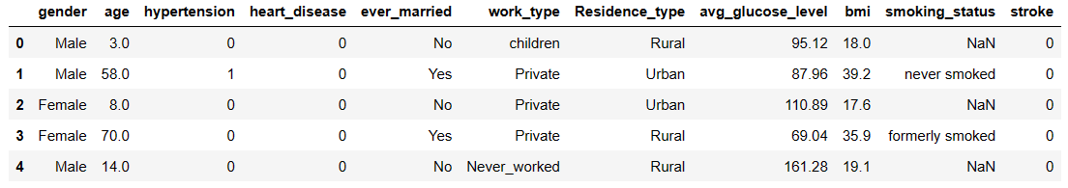
Data Pre-processing
No. of. rows in the dataset : 43400
No. of. Columns in the dataset : 11

Slide 15
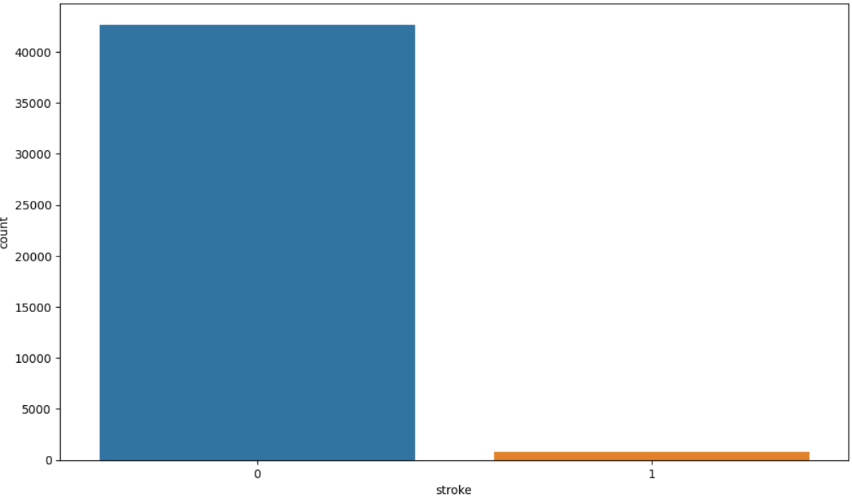
Data visualization
Count Plot

Slide 16
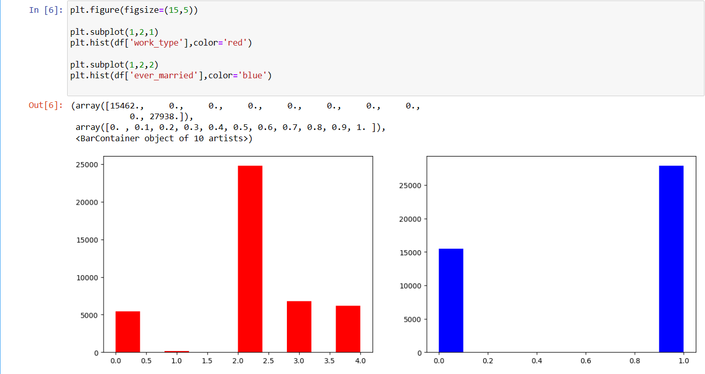
Sub-Plot

Slide 17
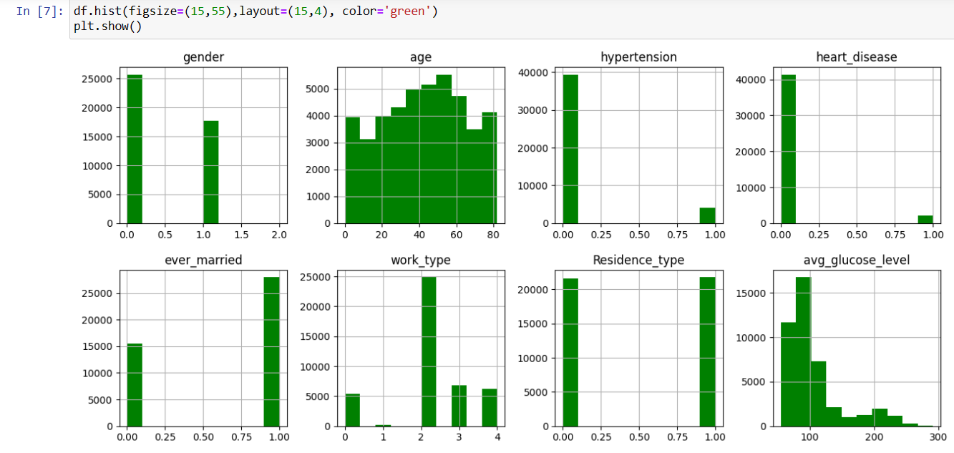
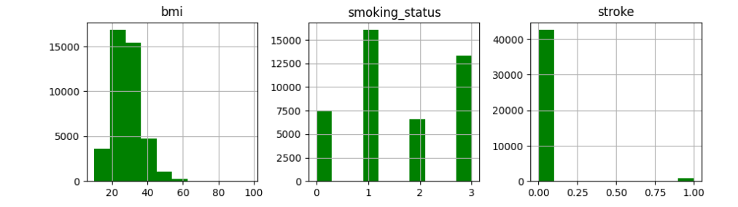
Hist-plot

Slide 18
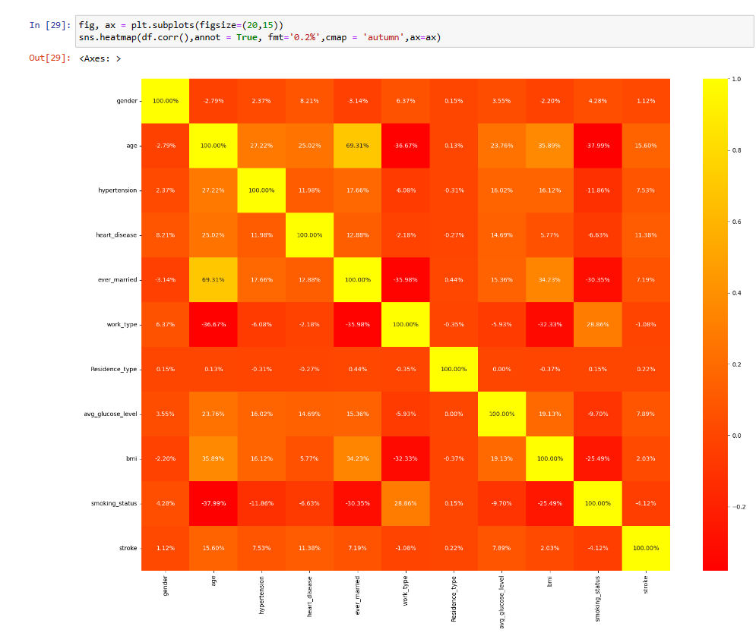
Correlation Heat Map

Slide 19

Adaboost Algorithm
Ada Boost Classifier from the sklearn library has been imported.
The dataset has been split into 80:20 as training and testing data.
ADB = AdaBoostClassifier(random_state=42)
ADB.fit(x_train,y_train)

Slide 20
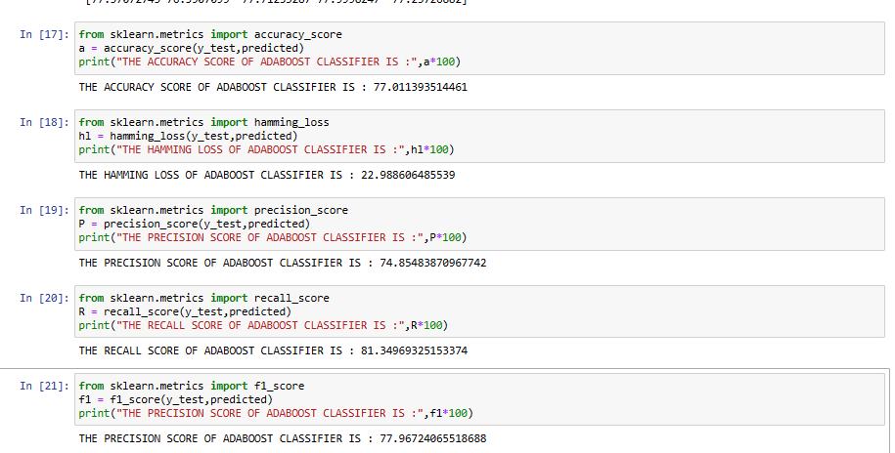
ACCURACY SCORE
From the classification report we have got an accuracy score of 77% for cerebral stroke.
Precision score as 74% for cerebral stroke
From the classification report we have got an recall score of 81% for cerebral stroke.
Recall Precision score as 77% for cerebral stroke

Slide 21
Bagging
Bagging Classifier from the sklearn library has been imported.
The dataset has been split into 80:20 as training and testing data.
ros =RandomOverSampler(random_state=42)
x,y=ros.fit_resample(x1,y1)
NUMBER OF TRAIN DATASET : 7572
NUMBER OF TEST DATASET : 1894
TOTAL NUMBER OF DATASET : 9466

Slide 22
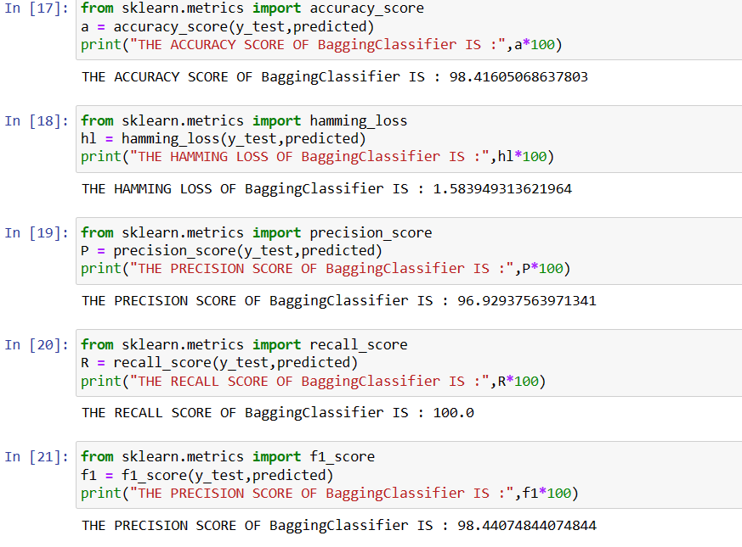
ACCURACY SCORE

Slide 23
K-Nearest Neighbour
K-Nearest Neighbour Classifier from the sklearn library has been imported.
The dataset has been split into 80:20 as training and testing data.
ros =RandomOverSampler(random_state=42)
x,y=ros.fit_resample(x1,y1)
NUMBER OF TRAIN DATASET : 7572
NUMBER OF TEST DATASET : 1894
TOTAL NUMBER OF DATASET : 9466

Slide 24
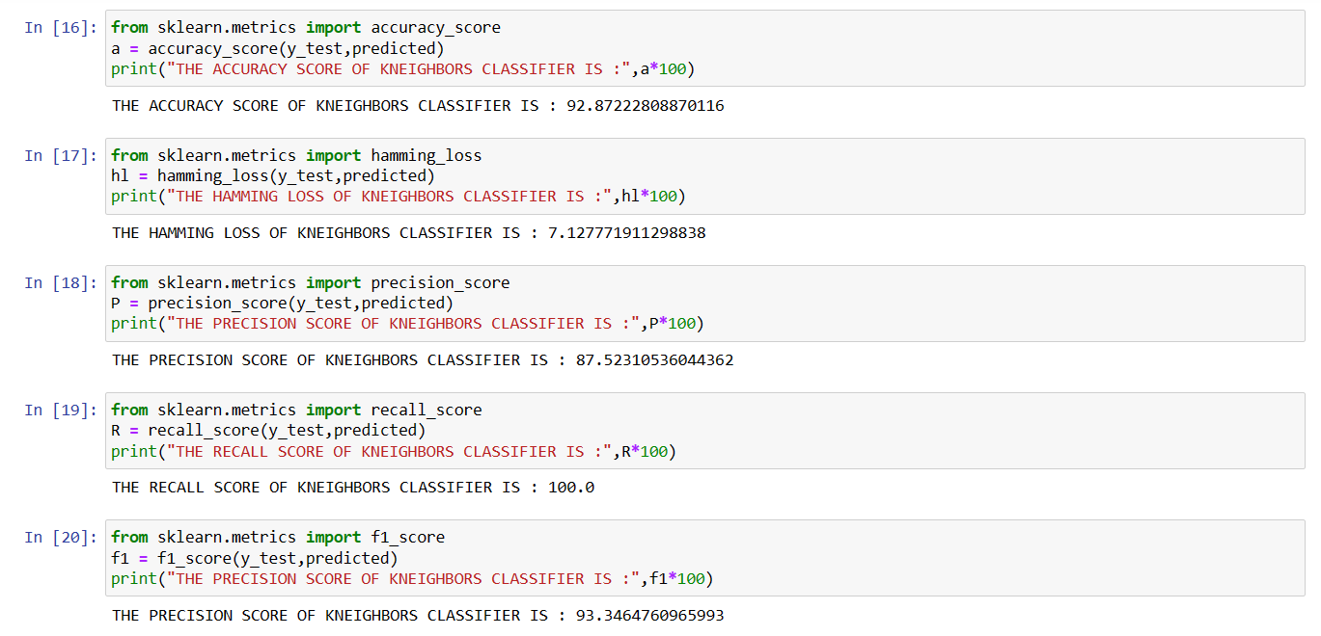
ACCURACY SCORE

Slide 25
Decision Tree
Decision tree Classifier from the sklearn library has been imported.
The dataset has been split into 80:20 as training and testing data.
ros =RandomOverSampler(random_state=42)
x,y=ros.fit_resample(x1,y1)
NUMBER OF TRAIN DATASET : 7572
NUMBER OF TEST DATASET : 1894
TOTAL NUMBER OF DATASET : 9466

Slide 26
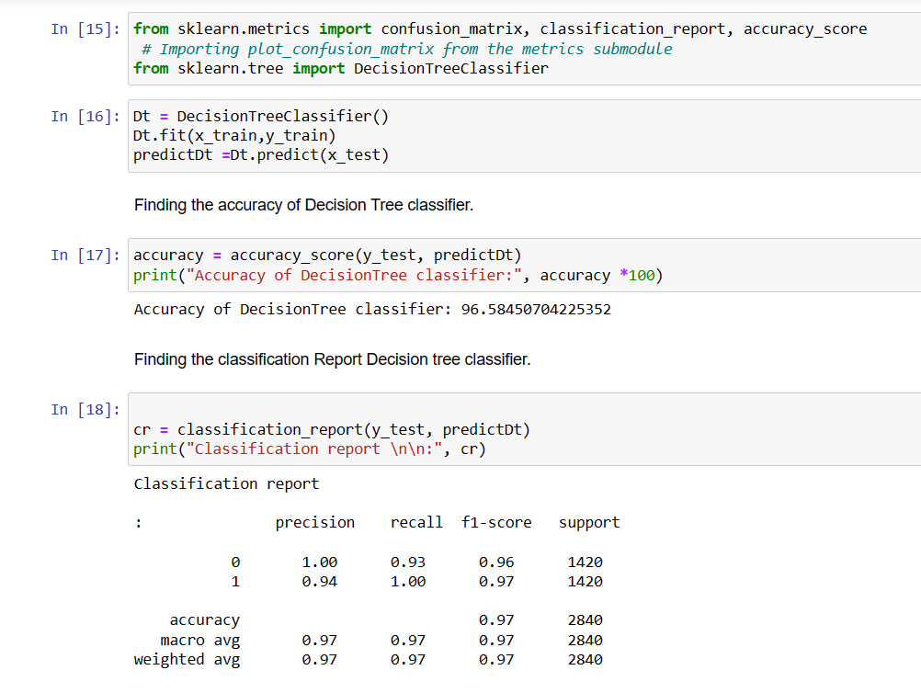
ACCURACY SCORE

Slide 27
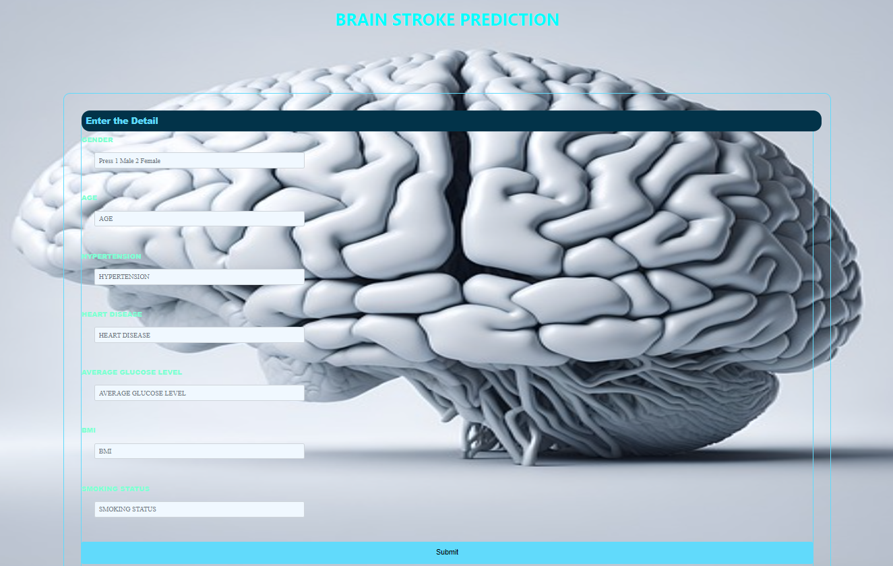
OUTPUT SCREENSHOT

Slide 28
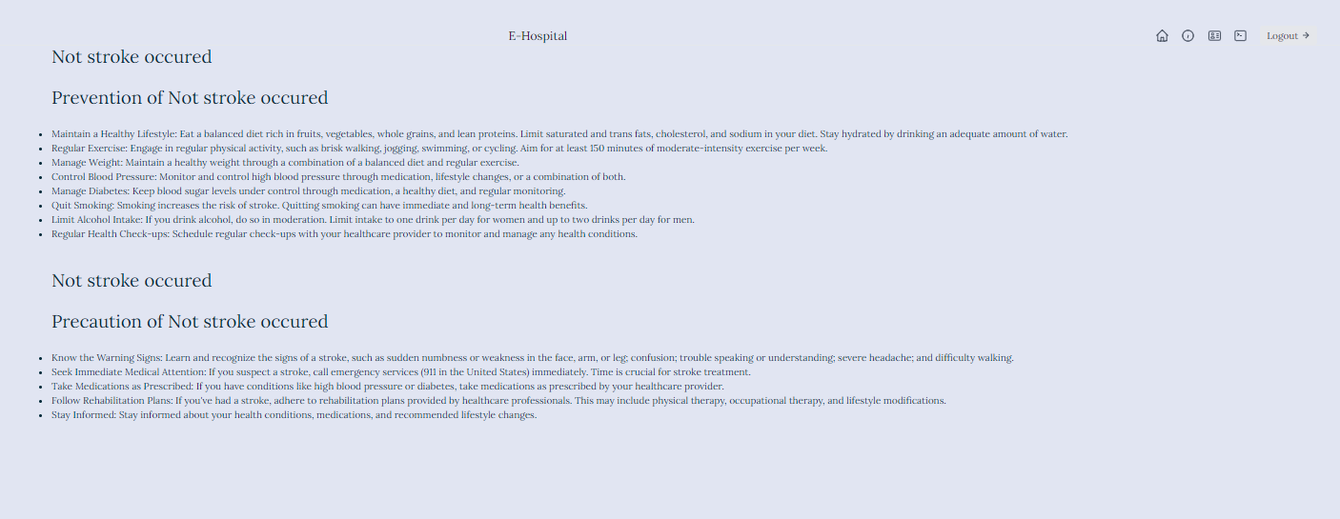

Slide 29
ENVIRONMENTAL REQUIREMENTS
Software Requirements:
Operating System : Windows
Tool : Anaconda with Jupyter Notebook
Hardware requirements:
Processor : intel i3
Hard disk : minimum 80 GB
RAM : minimum 4 GB

Slide 30
Reference
1. Mr.M.THIRUNAVUKKARASU, et. al. International Journal of Engineering Research and Applications, www.ijera.com
2. A Unified Visual Information Preservation Framework for Self-supervised Pre-Training in Medical Image Analysis.
3. Brain Stroke Classification via Machine Learning Algorithms Trained with a Linearized Scattering Operator.
4. Predictive modeling and classification for Stroke using the machine learning methods
5. Supervised learning approach for stroke predicition using deep learning
6. Analysis and Prediction of Stroke using Machine Learning Algorithm

Slide 31
THANK YOU...!

